Slide 1

IPDGC/GP2 Hackathon 2021 Project 2: Colocalization Pipeline
Shilpa Rao, Konstantin Senkevich, Prabhjyot Saini, Paula Reyes P, Will Scotton, Anni Moore & Devina Chetty

Slide 2
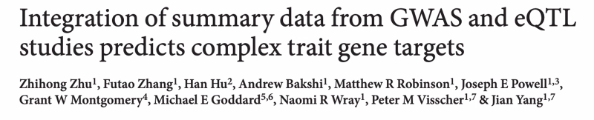
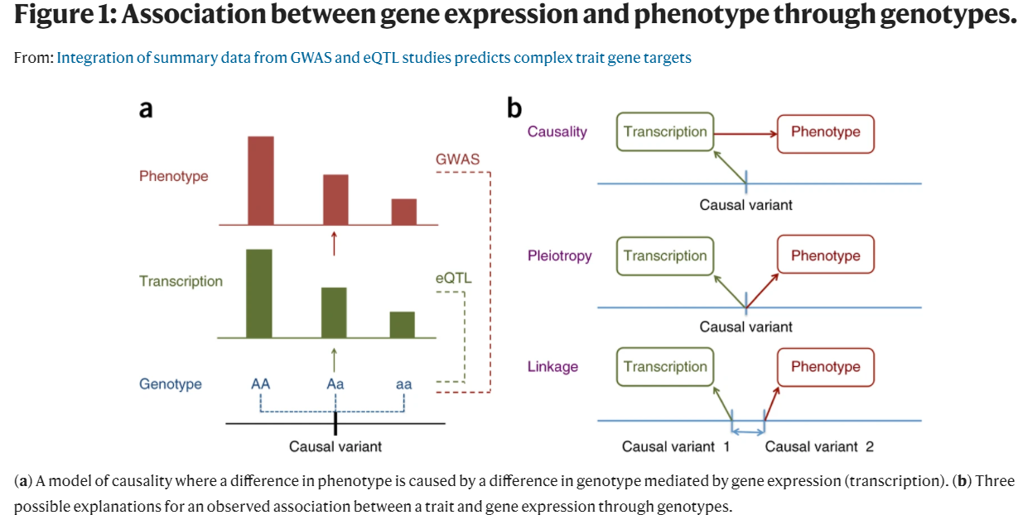
What is colocalization?
Colocalization is an analysis to test if the effect size of a SNP on the phenotype is mediated by gene expression.
This tool can be used to prioritize genes underlying GWAS hits

Slide 3
Methodology: Coloc vs SMR vs eQTpLOT
Coloc
Assumes a single causal variant
Reduced power in the presence of multiple casual variants
SMR
Integrates eQTL results to determine target genes of complex trait-associated GWAS loci
Derives an approximate X2-statistic for the mediating effect of the target gene expression on the phenotype
eQTplot
Visualization of colocalization between eQTL and GWAS data
Comprehensive plots of colocalization between GWAS and eQTL signals and correlation between GWAS and eQTL p-values
It provides visual information of effect size, direction of the effect, and distinguishes between congruous and incongruous effects

Slide 4
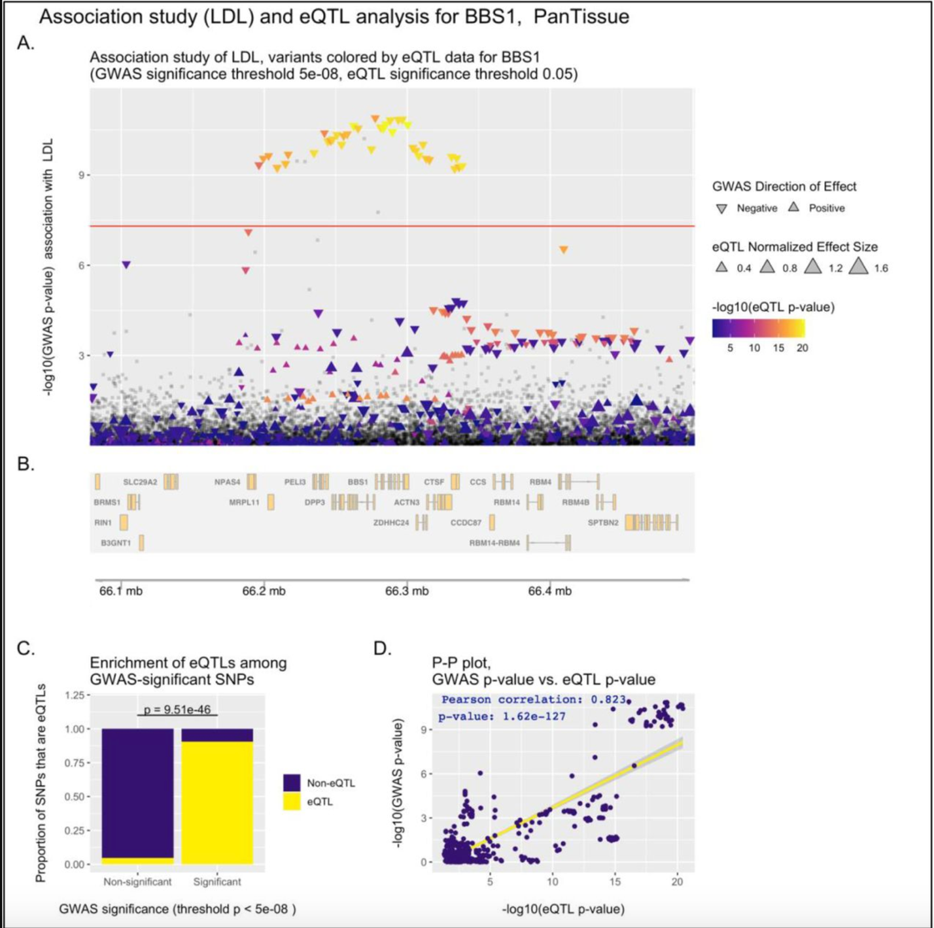
Methodology: Coloc vs SMR vs EQTpLOT
Integrates eQTL results to determine target genes of complex trait-associated GWAS loci
Coloc
SMR
eQTpLot
Visualization of colocalization between eQTL and GWAS data
Assumes a single causal variant

Slide 5
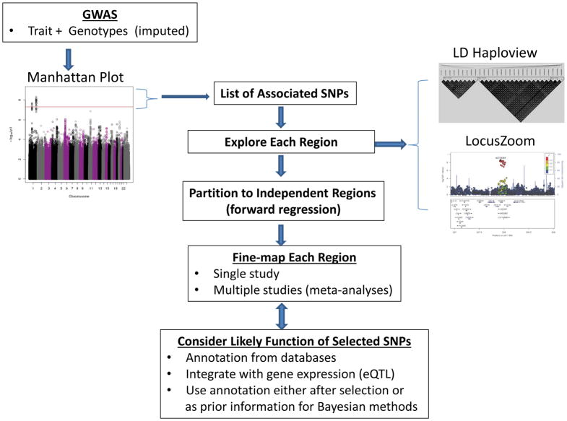
Fine-mapping
The process by which a trait-associated region from a GWAS is analysed to identify the particular genetic variants that are likely to causally influence the examined trait
Schaid DJ, Chen W, Larson NB. From genome-wide associations to candidate causal variants by statistical fine-mapping. Nat Rev Genet. 2018;19(8):491-504. doi:10.1038/s41576-018-0016-z

Slide 6
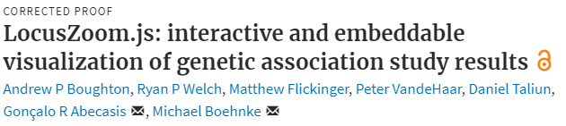
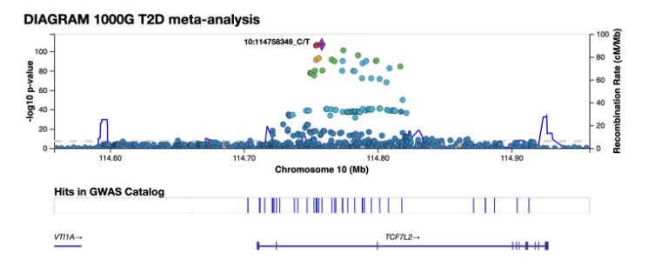
LocusZoom Plot
LocusZoom is a suite of tools to provide fast visualization of GWAS results for research and publication.

Slide 7
Links to tools we used
https://www.eqtlgen.org/
https://pubmed.ncbi.nlm.nih.gov/31701892/
(Identification of novel risk loci, causal insights, and heritable risk for Parkinson's disease: a meta-analysis of genome-wide association studies - PubMed)
https://github.com/chr1swallace/coloc
(Repo for the R package coloc)

Slide 8
Issues we’ve faced…
Couldn't load cloud environment (error)
CPU issues where kernel error would generate if CPU wasn't high enough, but when increased we would not have the running cloud environment

Slide 9
Thank you for listening!
Any questions?

